Slide 1
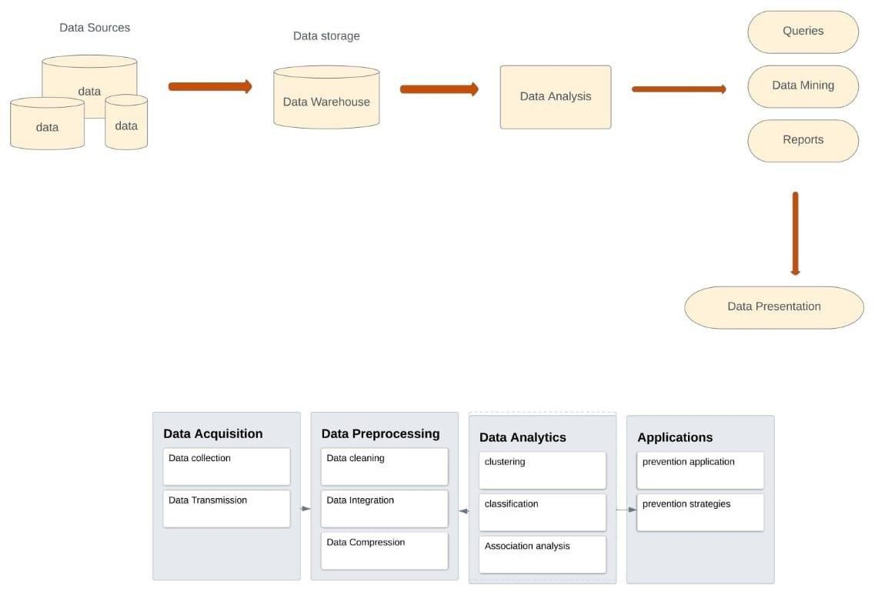
PROJECT DESIGN PHASE – II
TECHNOLOGY ARCHITECTURE
Project Design Phase | Technology Architecture
Name | S.Bharathi
Project Name | Analytics for Hospital Healthcare Data
Domain | Data Analytics

Slide 2
Table – 1 : Components and Technologies
S.NO | Component | Description | Technology
1 | User Interface | The user interacts with application using web UI | HTML , CSS, Javascript
2 | Database | Datatype and Configurations | MySQL
3 | File Storage | File storage requirements | IBM blocks storage or other storage service
4 | Cloud Database | Database service on Cloud | IBM Cloudant
5 | Prediction | ML algorithms are used for predicting the length of stay | ML algorithms – Random Forest, Decision tree
Table – 2 : Applications Characteristics:
S.NO | Component | Description | Technology
1 | Open source framework | Open source frameworks used | Python
2 | Security Implementations | The security controls implemented use of firewalls | Firewall, Antivirus
3 | Scalable Architecture | Scalability consists of 3 tiers | Supports higher workloads
4 | Availability | Justify the availability of application | AWS used
5 | Performance | Design consideration for the performance of the application | Dashboard, Report, Stories

